Slide 1

Knowledge is Power (Shell)
What’s new in PowerShell 3.0
Martin Schvartzman
maschvar@microsoft.com
Senior Premier Field Engineer | Microsoft Services

Slide 2
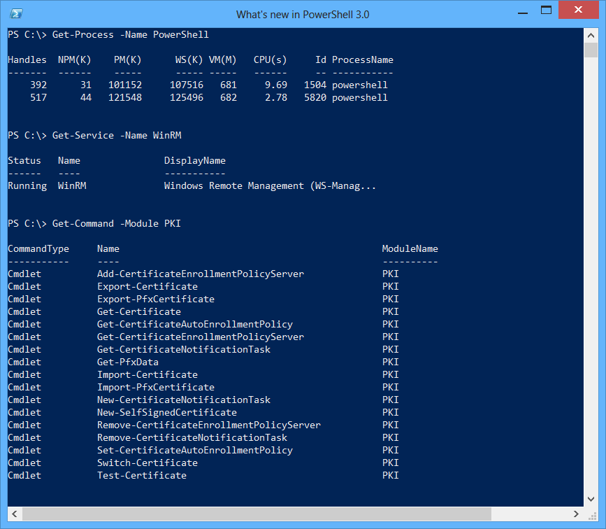
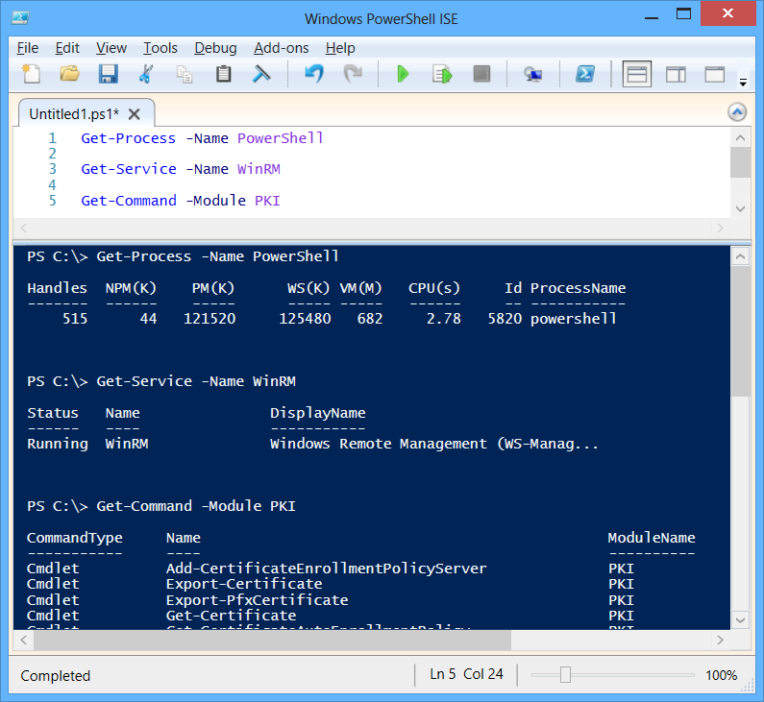

What is Windows PowerShell?
Console
Interactive commands
Query and configure
Run jobs
Scripting language
Automate everything
Sharable and reusable

Slide 3

The Journey
PowerShell 1.0
Introduced a great scripting language
for local machine management
Microsoft Exchange made a big bet on PowerShell
Optional feature in Windows Server 2008
PowerShell 2.0
Introduced Remoting
Introduced ISE
Introduced Modules
Pre-installed in Windows 7 and Windows Server 2008 R2

Slide 4

Available Everywhere
Windows 8, Windows RT, & Windows Server 2012
PowerShell Remoting enabled by default on server SKUs
With or without Server Graphical Shell or Graphical Management Tools
Windows Preinstallation Environment (WinPE) 4.0
Windows Management Framework 3.0
Windows Server 2008 / Windows 7 / Windows Server 2008 R2 (+Server Core)

Slide 5

Coverage Comparison
Windows Server 2008 R2 shipped with 587 cmdlets
Windows Server 2008 R2 shipped with 12 modules
How many cmdlets shipped in Windows Server 2012?
2032
2192
2353
2418
How many modules shipped in Windows Server 2012?
56
67
79
86

Slide 6

Windows PowerShell 3.0 Features
Windows PowerShell Workflow
.NET Framework 4 support
Add-Member improvements
Computer cmdlets
CSV handling improvements
Get-ChildItem attributes
Get-Command improvements
Get-Content -Tail
Disconnected sessions
Better history support
Security cmdlet fixes
Select-Object optimizations
Select-String improvements
Tee-Object -Append
Idle timeout & server buffering control
Invoke-Command in disconnected sessions
Disconnected jobs
STA mode by default
Run with PowerShell context menu
Updated console font & branding
Console host start perf improvements
ETW logging and tracing
Scheduled jobs
New Group Policy settings
Output redirection for all streams
Dynamic types & formats
Word wrap
Default properties on custom objects
Updatable help system
Method overload discovery
HelpUri attribute support
HelpFile property on FunctionInfo
Custom parameter value defaults
Simplified Where and ForEach
Remoting local variables via $using
Array syntax for scalars
New parser built on DLR
Generic method invocation
Typecasting deserialized objects
Improved method overload selection
New objects from hash tables
Ordered hash tables
Typecasting for parameter values
Pipeline paging APIs
Nested pipeline APIs
$PSScriptRoot and $PSCommandPath
Improved module discovery & import
New module manifest keys
Public abstract syntax tree
Runspace pool cleanup API
Public tab completion
Windows RT API support
Obsolete cmdlet attribute
Verb & noun on FunctionInfo
Web & REST cmdlets
JSON cmdlets
CIM cmdlet authoring from WMI v2
CIM .NET APIs
Core CIM cmdlets
Runtime script compilation
Engine reliability improvements
Better Get-ChildItem network perf
Cmdlet definition files
Certificate provider improvements
Credentials for FileSystem provider
Alternate NTFS data stream support
Move-Item across drives
Remote module discovery & import
Remote session autodisconnect & retry
Transport options for remote sessions
Module logging
RunAs and SharedHost support
Job integration with Task Scheduler
Alternate credential support for jobs
Module autoloading
Command discovery improvements
Special character handling
LiteralPath support for core cmdlets
Improved tab completion
Session configuration files
Intellisense
Windows Management Framework 3.0
WinPE support
Windows RT support
Windows PowerShell Web Access
XAML-based workflows
Script-based workflows
Control Panel cmdlets
Unblock-File cmdlet
Workflow help
Cmdlet to activity conversion
Workflow persistence
Improved WMI object formatting
Heterogeneous object formatting
Workflow logging
Workflow extensibility
Common workflow parameters
Workflow execution environment
Windows PowerShell Web Services
Snippets
ISE Add-ons
IntelliSense support
Show-Command
Get-Help -ShowWindow
Restart Manager support
Script autosave support
Out-GridView -PassThru
XML syntax highlighting
Block select
Collapsible regions
Contextual F1 support
Script Explorer
Parameter Defaults
DEMO
PowerShell ISE
DEMO
Simplified ForEach
DEMO
PowerShell Web Access
DEMO
Command Discovery
DEMO
Module Autoloading
DEMO
Disconnected Sessions
DEMO

Slide 7
Windows PowerShell 3.0 Features
Windows PowerShell Workflow
.NET Framework 4 support
Add-Member improvements
Computer cmdlets
CSV handling improvements
Get-ChildItem attributes
Get-Command improvements
Get-Content -Tail
Disconnected sessions
Better history support
Security cmdlet fixes
Select-Object optimizations
Select-String improvements
Tee-Object -Append
Idle timeout & server buffering control
Invoke-Command in disconnected sessions
Disconnected jobs
STA mode by default
Run with PowerShell context menu
Updated console font & branding
Console host start perf improvements
ETW logging and tracing
Scheduled jobs
New Group Policy settings
Output redirection for all streams
Dynamic types & formats
Word wrap
Default properties on custom objects
Updatable help system
Method overload discovery
HelpUri attribute support
HelpFile property on FunctionInfo
Custom parameter value defaults
Simplified Where and ForEach
Remoting local variables via $using
Array syntax for scalars
New parser built on DLR
Generic method invocation
Typecasting deserialized objects
Improved method overload selection
New objects from hash tables
Ordered hash tables
Typecasting for parameter values
Pipeline paging APIs
Nested pipeline APIs
$PSScriptRoot and $PSCommandPath
Improved module discovery & import
New module manifest keys
Public abstract syntax tree
Runspace pool cleanup API
Public tab completion
Windows RT API support
Obsolete cmdlet attribute
Verb & noun on FunctionInfo
Web & REST cmdlets
JSON cmdlets
CIM cmdlet authoring from WMI v2
CIM .NET APIs
Core CIM cmdlets
Runtime script compilation
Engine reliability improvements
Better Get-ChildItem network perf
Cmdlet definition files
Certificate provider improvements
Credentials for FileSystem provider
Alternate NTFS data stream support
Move-Item across drives
Remote module discovery & import
Remote session autodisconnect & retry
Transport options for remote sessions
Module logging
RunAs and SharedHost support
Job integration with Task Scheduler
Alternate credential support for jobs
Module autoloading
Command discovery improvements
Special character handling
LiteralPath support for core cmdlets
Improved tab completion
Session configuration files
Intellisense
Windows Management Framework 3.0
WinPE support
Windows RT support
Windows PowerShell Web Access
XAML-based workflows
Script-based workflows
Control Panel cmdlets
Unblock-File cmdlet
Workflow help
Cmdlet to activity conversion
Workflow persistence
Improved WMI object formatting
Heterogeneous object formatting
Workflow logging
Workflow extensibility
Common workflow parameters
Workflow execution environment
Windows PowerShell Web Services
Snippets
ISE Add-ons
IntelliSense support
Show-Command
Get-Help -ShowWindow
Restart Manager support
Script autosave support
Out-GridView -PassThru
XML syntax highlighting
Block select
Collapsible regions
Contextual F1 support
Script Explorer
Parameter Defaults
DEMO
PowerShell ISE
DEMO
Simplified ForEach
DEMO
CIM Cmdlets
DEMO
PowerShell Web Access
DEMO
Command Discovery
DEMO
Workflows
DEMO
Scheduled Jobs
DEMO
Module Autoloading
DEMO
Disconnected Sessions
DEMO

Slide 8
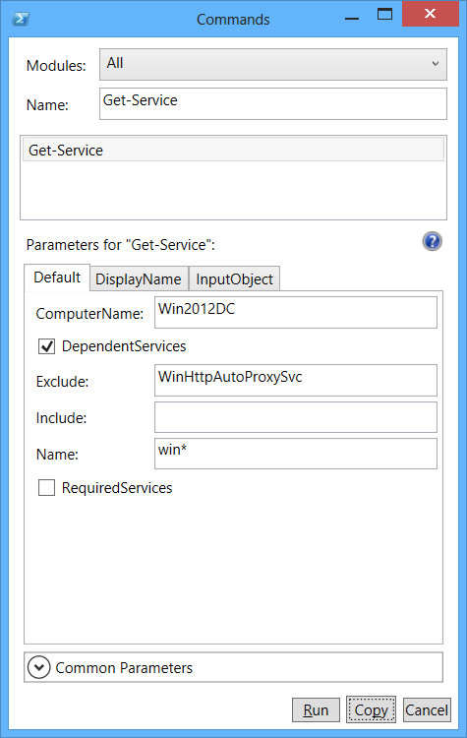
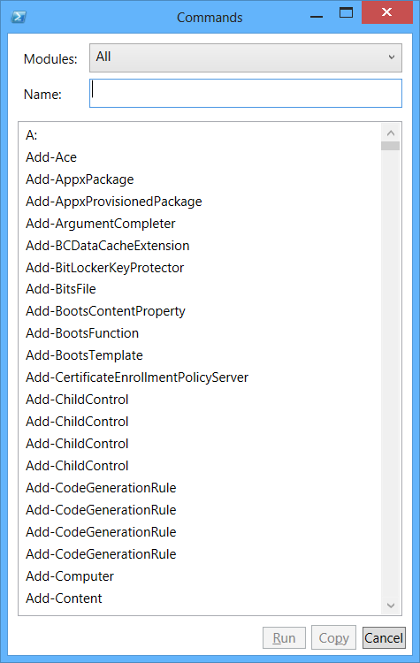

Command Discovery
The new Show-Command cmdlet is designed especially for beginners
Search for commands in a window
View all commands or filter by module
Import a module by clicking a button
Use text boxes and drop-down lists to
construct a valid command
Copy or run the command without
ever leaving the window
Notes:
# In PowerShell 2.0
Get-Help Get-Service
Get-Help Get-Service >>Get-Service.txt
notepad Get-Service.txt
# In PowerShell 3.0
Get-Help Get-Service -ShowWindow
# Investigate all cmdlets and their parameters
Show-Command
# Show module filtering (e.g. PrintManagement)
# Show ParameterSets tabs
# Show Common Parameters
# Show all dependant services on the ones named 'win*' but not including the WinHttpAutoProxySvc:
# -----------------------------------------------------------------------------------------------
# Search for: Get-Service
# ComputerName: DC01
# Check the 'DependentServices' checkbox
# Exclude: 'WinHttpAutoProxySvc'
# Name: win*
Show-Command Get-ChildItem
Show-Command Get-ChildItem -ErrorPopUp

Slide 9

Module Autoloading
PowerShell imports modules automatically the first time that you use any command in an installed module
Only module that are stored in the location specified by the PSModulePath environment variable are automatically imported
Controlled by the $PSModuleAutoLoadingPreference variable
All | Modules are imported automatically on first-use. To import a module, get (Get-Command) or use any command in the module.
ModuleQualified | Modules are imported automatically only when a user uses the module-qualified name of a command in the module. For example, if the user types "MyModule\MyCommand", Windows PowerShell imports the MyModule module.
None | Automatic importing of modules is disabled in the session. To import a module, use the Import-Module cmdlet.
Notes:
# List all loaded modules:
Get-Module
# Run a command from a non default Module:
Get-WebSite
# Show that the previous command auto-loaded the relevant module:
Get-Module
# Change the AutoLoading behavior:
$PSModuleAutoLoadingPreference = "None"
Get-Printer
Get-Module
# Enable back the Module-AutoLoading:
$PSModuleAutoLoadingPreference = "All"
Get-Printer
Get-Module
# ModuleQualified means you need to specify the cmdlet's "FQDN":
$PSModuleAutoLoadingPreference = "ModuleQualified"
Get-Volume
Storage\Get-Volume
Get-Module
# Be carefull, setting a worng value to $PSModuleAutoLoadingPreference might break things...
Get-C[TAB] # Works
$PSModuleAutoLoadingPreference = "blah"
Get-C[TAB] # This doens't work!
# "Mini-Module"
function Get-BIOS { Get-WmiObject -Class Win32_BIOS }
$name = 'Get-BIOS'
New-Item -Path $home\Documents\WindowsPowerShell\Modules\$name\$name.psm1 -ItemType File -Force -Value "function $name { $((Get-Item function:\$name).Definition) }"
Get-BIOS

Slide 10
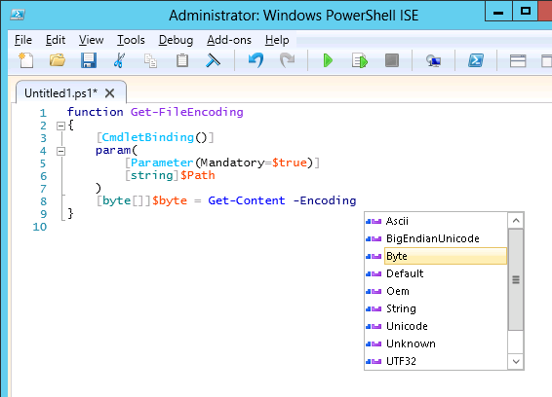

Windows PowerShell ISE
IntelliSense
Show-Command pane
Regions
F1 Help window
Rich copy
Snippets
Notes:
# Show the Command add-on (Show-Command window)
# Show the console input and output window are the same
# Show the intellisense
# Get-P<TAB> -<TAB>
# Get-*Item<TAB>
# Get-Service <TAB>
# (Get-Process -Name powershell).
# [System.I # O.Compression.CompressionLevel]::GetNames()
# $
# $a = 42
# $a.
#smart path completion:
dir c:\
cd c:\
# Use 'ReallyBigScriptFile.ps1' to show:
# Block Select
# Expand and collapse regions and scriptblocks
# Errors display (red squigly underline)
$Example - $
# Show snipptes (CTRL+J) - e.g. switch
# Show the color and themes (Tools - Options)
# Show the AutoSave option and AutoRecovery
# Depending on the time, mention the NEW-SNIPPET cmdlet or show the usage as described below:
# Create a new snippet:
New-IseSnippet -Title "Get them Bits" -Description "Gets the Bits service controller" -Text "Get-Service -Name 'Bits'"
# It creates a file under the userprofile folder
Invoke-Item $env:USERPROFILE\documents\WindowsPowerShell\Snippets
# Remove Snippet (Delete the file)
Get-IseSnippet | Where-Object { $_.Name -like "Get them Bits*" } | Remove-item -Force
# All snippets file from the $home folder will be loaded automatically when ISE starts
# Import snippet files from a specific folder:
Import-IseSnippet -Path 'C:\Temp'

Slide 11
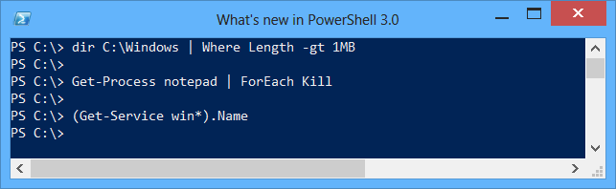

Simplified ForEach
Loops over the collection internally
If the member you specified is a property, you get back its value
If it's a method, it invokes the method on the each object
Notes:
# In PowerShell 2.0 you would execute something like this
dir C:\Windows | Where { $_.Length -gt 1MB }
# First of all, we've given $_ a better name: $PSItem
dir C:\Windows | Where { $PSItem.Length -gt 1MB }
# We've also removed the need for braces and $_/$PSItem altogether
dir C:\Windows | Where Length -gt 1MB
# We made the same changes to ForEach-Object
Get-Process p* | ForEach name
# The simplified syntax also works with methods
notepad.exe;notepad.exe;notepad.exe
Get-Process notepad
Get-Process notepad | ForEach kill
Get-Process notepad
# Another issue we targeted with the same approach was arrays
PowerShell -v 2
$PSVersionTable
$a = Get-Service WinRM
$a
$a.Name
$b = Get-Service Win*
$b
$b.Name
exit
# Now, in PowerShell 3.0, you can
$c = Get-Service Win*
$c
$c.Name
# We also made it to work the other way arround
$d = Get-Service WinRM
$d.GetType()
$d[0].Name
$d | Get-Member
$d.Length

Slide 12
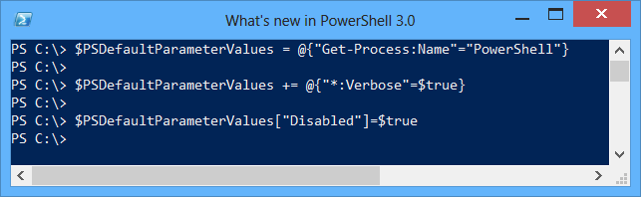

Parameter Defaults
The $PSDefaultParameterValues preference variable lets you specify custom default values for any cmdlet or advanced function
Useful when you must specify the same parameter value nearly every time you use the command or when a particular parameter value is difficult to remember
You can specify a script block that provides different default values for a parameter under different conditions
Notes:
# Having default parameter values, can help you become a lazy powershell guy like me
$PSDefaultParameterValues = @{"Get-Process:Name"="notepad"}
$PSDefaultParameterValues
Get-Process
Get-Service | Export-Csv C:\Temp\services.csv
notepad C:\Temp\services.csv
$PSDefaultParameterValues = @{"Export-Csv:NoTypeInformation"=$true}
Get-Service | Export-Csv C:\Temp\services.csv
notepad $$
# You can also use wildcards for the hashtable's key
$PSDefaultParameterValues = @{"*-Service:Name"="Bits";
"*:Credentials"=(Get-Credential 'CONTOSO\Administrator')}
Get-Service
# A more real life example would be
$PSDefaultParameterValues = @{"Get-WmiObject:ComputerName"="Web2012";
"Get-WmiObject:Credentials"=(Get-Credential 'CONTOSO\Administrator');
"*-AD*:Server" = 'DC01'}
$PSDefaultParameterValues
Get-WmiObject Win32_ComputerSystem
# You can obviously still use different values for the parameters
Get-WmiObject Win32_ComputerSystem -ComputerName .
<#
$PSDefaultParameterValues = @{
"Send-MailMessage:From" = "maschvar@microsoft.com";
"Send-MailMessage:SmtpServer" = "smtphost.redmond.corp.microsoft.com";
"Send-MailMessage:Credential" = (Get-Credential maschvar@microsoft.com) }
#>
$PSDefaultParameterValues = @{
"Send-MailMessage:From" = "martin77s@outlook.com";
"Send-MailMessage:SmtpServer" = "smtp.live.com";
"Send-MailMessage:UseSsl" = $true;
"Send-MailMessage:Port" = 587;
"Send-MailMessage:Credential" = (Get-Credential martin77s@hotmail.com)
}
# Send mail with a lot less typing
Send-MailMessage -To maschvar@microsoft.com -Subject "Email from the user group!"
# You can also use scriptblocks
Get-Process | Select-Object Name, ID, Handles
Get-Process | Select-Object Name, ID, Handles | Format-Table -AutoSize
$PSDefaultParameterValues += @{"Format-Table:AutoSize"={if ($Host.Name –eq "ConsoleHost"){$true}}}
Get-Process | Select-Object Name, ID, Handles | Format-Table
#Another use would be to imitate the $WhatIfPreference preference variable
$PSDefaultParameterValues += @{"*:WhatIf"=$true}
# To keep the PSDefaultParameterValues values but disable the behavior
$PSDefaultParameterValues["Disabled"] = $true
$PSDefaultParameterValues
# To enable back the PSDefaultParameterValues behavior
$PSDefaultParameterValues.Remove("Disabled")
# To completly clear the PSDefaultParameterValues
$PSDefaultParameterValues.Clear()
$PSDefaultParameterValues

Slide 13

Scheduled Jobs
Job Scheduling allows you to schedule the execution of a PowerShell background job
Support for a rich set of triggers
Run commands according to schedule or in response to an event
PSScheduledJob module with 16 cmdlets
*-JobTrigger to create scheduled triggers
*-ScheduledJob to register, unregister, and change scheduled job definitions
*-ScheduledJobOption to configure advanced settings
*-Job to retrieve results
Notes:
# Note all the PSScheduledJob related cmdlets:
Get-Command -Module PSScheduledJob | Sort-Object Noun
# Using the New-JobTrigger cmdlet, we can create different types of triggers:
Get-Command New-JobTrigger -Syntax
# We can "randomly" delay tasks that are set to start 'AtLogOn' or 'AtStartup':
Get-Help New-JobTrigger -Parameter RandomDelay
# Let's create a few triggers:
$DailyTrigger = New-JobTrigger -Daily -At '03:00'
$OneTimeTrigger = New-JobTrigger -Once -At ((Get-Date).AddHours(1))
$WeeklyTrigger = New-JobTrigger -Weekly -DaysOfWeek 'Friday' -At '17:00'
# Let's create a 'one-time' ScheduledJob to backup our files:
Register-ScheduledJob -Name 'BackUpFiles' -Trigger $OneTimeTrigger -ScriptBlock { Copy-Item -Path 'C:\myFiles' -Destination "C:\BackUp\$((Get-Date).ToFileTime())" }
# Let's create a 'weekly' ScheduledJob to send a report:
Register-ScheduledJob -Name 'SendWeeklyReport' -Trigger $WeeklyTrigger -FilePath 'C:\Temp\WeeklyReport.ps1'
# List all ScheduledJobs:
iex 'C:\windows\system32\taskschd.msc'
Get-ScheduledJob
# When is the job scheduled to run?
Get-ScheduledJob -Name 'BackUpFiles' | Get-JobTrigger
# Advanced options:
Get-ScheduledJobOption -Name 'BackUpFiles'
Get-ScheduledJobOption -Name 'BackUpFiles' | Set-ScheduledJobOption -RunElevated -MultipleInstancePolicy Queue -RequireNetwork
Get-ScheduledJobOption -Name 'BackUpFiles'
Get-ScheduledJob -Name 'BackUpFiles' | Set-ScheduledJob -Credential (Get-Credential 'CONTOSO\Administrator')
# TaskScheduler Operational events in the Event Viewer:
Get-WinEvent -LogName Microsoft-Windows-TaskScheduler/Operational
# Remove all ScheduledJobs:
Get-ScheduledJob
Get-ScheduledJob | Unregister-ScheduledJob
Get-ScheduledJob
# All this is only to manage the PowerShell ScheduledJobs
# To manage other Scheduled Tasks, you still need to use:
$tasks = SCHTASKS /v /fo CSV | ConvertFrom-CSV
#OR:
$sch = New-Object -ComObject Schedule.Service
$sch.Connect($Computer)
$tasks = $sch.GetFolder("\").GetTasks(0)

Slide 14

Robust Session Connectivity
Remote sessions remain in a "Connected" state during transient network glitches or failures for up to 4 minutes
After 4 minutes, remote sessions automatically transition to a new "Disconnected" state
Persistent commands and jobs can continue to run even if the session is disconnected
Client can reconnect to a disconnected session after network connectivity with the server has been restored
New cmdlets for managing disconnected sessions
New session features are only available if both client and server are running PowerShell 3.0
Notes:
# (From Win7vs)
# In PowerShell 3.0, Remoting is enabled by default and FireWall rules are set
Enable-PSRemoting -Force
# Create a remote session:
$s = New-PSSession -ComputerName DC01 -Name DemoPSSession
$s
# Process wsmprovhost.exe is still the hosting process
Get-Process -Name wsm* -ComputerName DC01
# Enter the session:
Enter-PSSession $s
# Note the $Host.Name
$Host
# Create a few variables in the remote session:
$name = "Martin"
$date = Get-Date
# Exit and disconnect the session:
exit
Disconnect-PSSession -Session $s
# We can then close PowerShell, and open it on a different machine.
# The following command will show what sessions are available on the target server:
Get-PSSession -Computername DC01
# Enter the disconnected session:
$a = Get-PSSession -Computername DC01 -Name DemoPSSession
Enter-PSSession $a
# Show the variables and their previously set values:
$name
$date
# (From Web2012)
# But if you want to run a long running job on the remote session:
$s = New-PSSession -ComputerName DC01 -Name JobDemoPSSession
$job = Invoke-Command $s { 1..1000000 | ForEach-Object { Start-Sleep 1; Get-Date -DisplayHint Time } } -AsJob -JobName myJob
$job
Get-Job myJob | Receive-Job -Keep
# Disconnect the session:
Disconnect-PSSession $s
# While the session is disconnected, it can cache upto 2GB of data IN THE MEMORY)
# (From Win7vs)
Get-PSSession -ComputerName DC01
$s = Get-PSSession -ComputerName DC01 -Name JobDemoPSSession | Connect-PSSession
Receive-PSSession $s -OutTarget Job -JobName myJob
Get-Job myJob | Receive-Job -Keep
# And if you just want to start something and go home directly after that:
Invoke-Command -ComputerName DC01 -ScriptBlock { 1..1000000 | ForEach-Object { Start-Sleep 1; Get-Date -DisplayHint Time } } -InDisconnectedSession -SessionName NightlyJobSession

Slide 15




PowerShell Web Access
Acts as a Windows PowerShell gateway, providing a web-based PowerShell console
Can be used to connect to a remote computer
Built for phones, tablets, and mobile devices as well as PCs
Cross-platform support
IE
Firefox
Safari
Chrome
Opera
Client
Browser
Internet
Access
PowerShell
WebAccess
Corporate Network
Notes:
# Install the role:
Get-WindowsFeature *PowerShell*
Install-WindowsFeature WindowsPowerShellWebAccess
# To install the IIS Manager console as well, use the IncludeManagementTools switch parameter:
Install-WindowsFeature WindowsPowerShellWebAccess -IncludeManagementTools
# Install WebApplication:
Get-Command *pswa*
Install-PswaWebApplication -UseTestCertificate # Not recommended for Production environments. The test certificate expires in 90 days.
# Add Authorization Rules:
Get-PSSessionConfiguration | Select-Object Name
# To a user, on a specific computer, for a specific configuration
Add-PswaAuthorizationRule -UserName 'Web2012\Administrator' -ComputerName DC01 -ConfigurationName Microsoft.PowerShell
# To a group, on all computers, for all configurations
Add-PswaAuthorizationRule -UserGroupName 'CONTOSO\Domain admins' -ComputerName * -ConfigurationName *
# To everyone
Add-PswaAuthorizationRule * * *
# Test the Authorization rule
$a = Get-PswaAuthorizationRule -Id 0
Test-PswaAuthorizationRule -Rule $a -ComputerName DC01 -UserName CONTOSO\Administrator
# Web Access:
Start iexplore https://localhost/pswa
# Note that the hotkeys you might have been used to, no longer work in the web console
# Let's try to connect back to the disconnected session we ran on the previous demo
$cred = Get-Credential
Get-PSSession -Computername DC01 -Credential $cred
$s = Get-PSSession -ComputerName DC01 -Name NightlyJobSession -Credential $cred | Connect-PSSession
Receive-PSSession $s -OutTarget Host
# PSWA Operational events in the Event Viewer:
Get-WinEvent -LogName Micrososft-Windows-PowershellWebAccess/Operational

Slide 16
CIM Cmdlets
Uses WinRM (no need to open high ports anymore)
First, create CIM session
$cim = New-CimSession –ComputerName Server1
Then, use like “regular” WMI
Get-CimInstance -ClassName Win32_BIOS -CimSession $cim
Many WMI classes already “wrapped”
Over 800 functions
Permits: Get-Disk, Get-Volume, Get-NetAdapter
Notes:
# WinRM WSMAN WinRM OMI/OpenWSMAN/etc.
# Windows <---> Windows & Everyone Else
#
# Now WMI is exposed to standard WSMAN consumers, even if they are not on the Windows platform.
# Now Windows PowerShell can interact with WSMAN standard network devices and PCs on other platforms.
# WSMAN gets around the port limitations of WMI/RPC/DCOM.
Set-Item WSMan:\localhost\Client\TrustedHosts -Value "*" -Force
$cred = Get-Credential 'CONTOSO\Administrator'
# Looks like WMI
Get-WmiObject Win32_BIOS
Get-CimInstance Win32_BIOS
# *** FROM DC01 ***
# v2 - DCOM - Random ports (TimeOuts after 30 seconds)
Get-WmiObject Win32_BIOS -ComputerName Web2012
# v3 - WMI over WSMAN - Port 5985
Get-CimInstance Win32_BIOS -ComputerName Web2012
# *******
# CIM Sessions
# v3 - Using the CIM session is more efficient than WMI cmdlets.
# Open the session once and reuse it for multiple commands.
$c = New-CimSession -ComputerName 10.0.0.1, 10.0.0.112 -Credential (Get-Credential 'CONTOSO\Administrator')
$c
Get-CimInstance Win32_BIOS -CimSession $c
Get-CimInstance Win32_ComputerSystem -CimSession $c
Get-CimInstance Win32_OperatingSystem -CimSession $c
Get-Help Get-CimInstance -Parameter *
#(e.g. -OperationTimeoutSec)
# Cmdlets for CIM
Get-Command *CIM*
# Cmdlets with parameter for CIMSession
Get-Command -ParameterName CimSession
# Create a CIM session to multiple remote machines from a text file
# Set the credentials once and never type them again
$s = New-CimSession -ComputerName 10.0.0.112 -Credential (Get-Credential)
# Then pass the session with the CIMSession Parameter
# Note the progress bar
Get-Disk -CimSession $s
Get-Volume -CimSession $s
Get-NetIPAddress -CimSession $s | Out-GridView
Get-DnsClientServerAddress -CimSession $s | Where ServerAddresses | Select PSComputername, ServerAddresses | Out-GridView
$c | Remove-CimSession
$s | Remove-CimSession

Slide 17
PowerShell Workflow
A high-level orchestrated execution (not just another way to script)
Provides flexibility for reliably running sequenced, parallel, and long-running tasks
Supports persistence, can "survive" restarts using checkpoints
Built on Windows Workflow Foundation and .NET 4.0
Author workflows as PowerShell scripts or using XAML, management through *-Job cmdlets
Notes:
# The workflow syntax is simillar to a function
WorkFlow Hello-WorkFlow
{
"Hello From Workflow"
}
Hello-WorkFlow
Get-Command Hello-WorkFlow
Get-Command Hello-WorkFlow -Syntax
# 6 CommonParameters and 24 WorkflowCommonParameters
(Get-Command Hello-WorkFlow).Parameters.Count
WorkFlow Parallel-WorkFlow
{
Param([string[]]$ComputerName)
foreach -parallel($Computer in $ComputerName)
{
"Step 1 on $Computer"
"Step 2 on $Computer"
}
}
Get-Command Parallel-WorkFlow -Syntax
Parallel-WorkFlow "Server1","Server2","Server3","Server4","Server5","Server6"
WorkFlow MixedParallelSequential-WorkFlow {
# All Commands in a Parallel block can happen in any order
parallel
{
"Parallel Activity 1"
"Parallel Activity 2"
"Parallel Activity 3"
# All the commands in a Seqeunce block are gaurented to run in sequencial order
sequence
{
"Sequential Activity A"
"Sequential Activity B"
"Sequential Activity C"
"Sequential Activity D"
"Sequential Activity E"
"Sequential Activity F"
}
"Parallel Activity 4"
"Parallel Activity 5"
"Parallel Activity 6"
}
}
MixedParallelSequential-WorkFlow
# You can delegate the workflows!
cd WSMan:\localhost\Plugin\microsoft.powershell.workflow
dir
# Note the RunAsUser & RunAsPassword
$cred = Get-Credential 'CONTOSO\Administrator'
Set-Item .\RunAsUser -Value $cred
Restart-Service winrm
WorkFlow Long-WorkFlow
{
While(1)
{
"Long WorkFlow: " + (Get-Date)
Start-Sleep -Seconds 2
}
}
WorkFlow Long-WorkFlow
# If you want to see the WorkFlow's XAML definition
Get-Command WorkFlow Long-WorkFlow | Select-Object -ExpandProperty XamlDefinition
# Invoke the WorkFlow Long-WorkFlow as a job
$wfJob = Long-WorkFlow -AsJob
# Get the job's status
$wfJob
# Get the job's output data
Receive-Job $wfJob
# Susped the job invocation
Suspend-Job $wfJob
# Check the job's status (should be Suspended)
$wfJob
# Get the job's output data (should be nearly empty)
Receive-Job $wfJob
# Resume the job invocation
Resume-Job $wfJob
# Clean up
Get-Job | Remove-Job -Force

Slide 18

PS 3.0 –gt PS 2.0
Simple and easy for new users
A lot more cmdlets
A lot of new features
Improved ISE
Improved Performance
Notes:
# A few more little things:
dir -s
dir C:\ -Attributes ReadOnly, Archive, System, Hidden
dir C:\ -att r,a,s,h
dir C:\ -att !d+!e+a
Restart-Computer -Wait -For #[WMI, WinRM, and PowerShell]
New-PSDrive -Name x -PSProvider FileSystem -Root C:\Scripts -Credential (Get-Credential)
x:
dir
c:
Remove-PSDrive x
Get-Process | Out-GridView -OutputMode Multiple | Get-Process | Select-Object Name, ID
Invoke-RestMethod http://blogs.msdn.com/b/powershell/rss.aspx | Select title, pubDate
Invoke-RestMethod http://blogs.msdn.com/b/powershell/rss.aspx | Select title, pubDate | ConvertTo-Json
# One last demo: PowerShell 3.0 -gt 2.0
# Open two consoles, one PowerShell -v 2 and one PowerShell -v 3
# Put them besides each other, and run C:\Temp\FireEffect.ps1

Slide 19

Resources
Download the Windows Management Framework 3.0:
http://www.microsoft.com/en-us/download/details.aspx?id=34595
Windows PowerShell Blog - Site Home - MSDN Blogs:
http://blogs.msdn.com/b/powershell/
PowerShell v3 Featured Articles - TechNet Wiki:
http://social.technet.microsoft.com/wiki/contents/articles/4741.powershell-v3-featured-articles-en-us.aspx
Windows PowerShell and Server Manager Quick References:
http://www.microsoft.com/en-us/download/details.aspx?id=30002
Notes:
# One last demo: PowerShell 3.0 -gt 2.0
# Open two consoles, one PowerShell -v 2 and one PowerShell -v 3
# Put them besides each other, and run C:\Temp\FireEffect.ps1

Slide 20
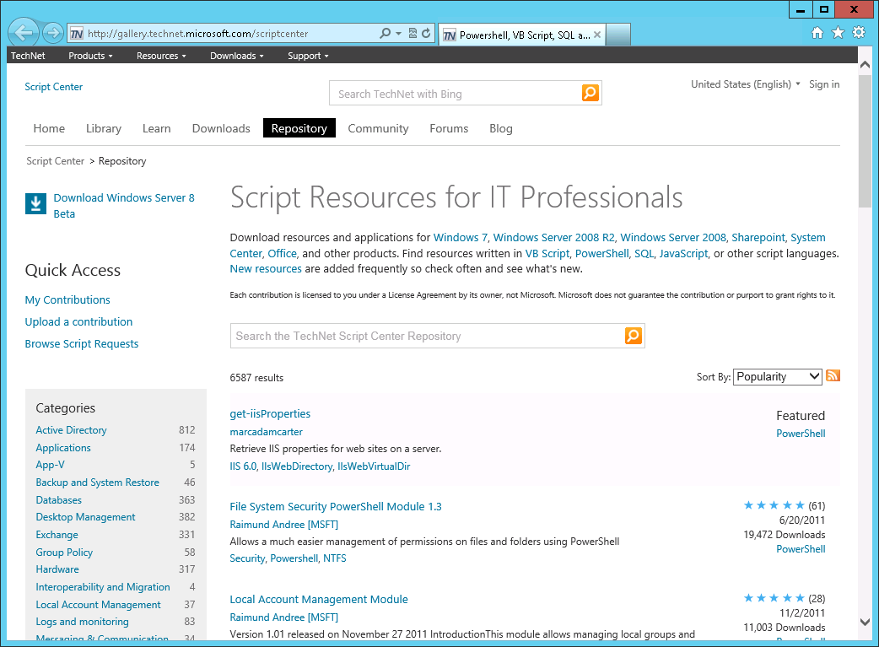
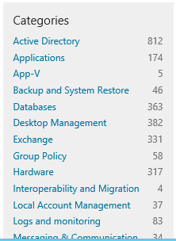
Rich Platform for Script Sharing
TechNet Script Center
Script Repository
Script Explorer
ISE Add-ons Website
PowerShell Modules
PoshCode.org
PowerShellCommunity.org
PowerShell.com
PowerShellGroup.org
Windows PowerShell ISVs
Notes:
GroupPolicy
Databases → SQL Server
Active Directory → Groups

Slide 21

Microsoft Virtual Academy
Windows Server 2012: Management & Automation
http://www.microsoftvirtualacademy.com/tracks/windows-server-2012-manageability-and-automation
Standards Based Management Framework
Server Management with Windows PowerShell 3.0
Multi-Server Management with Server Manager

Slide 22
© 2013 Microsoft Corporation. All rights reserved. Microsoft, Windows and other product names are or may be registered trademarks and/or trademarks in the U.S. and/or other countries.
The information herein is for informational purposes only and represents the current view of Microsoft Corporation as of the date of this presentation. Because Microsoft must respond to changing market conditions, it should not be interpreted to be a commitment on the part of Microsoft, and Microsoft cannot guarantee the accuracy of any information provided after the date of this presentation. MICROSOFT MAKES NO WARRANTIES, EXPRESS, IMPLIED OR STATUTORY, AS TO THE INFORMATION IN THIS PRESENTATION.

